Slide 1
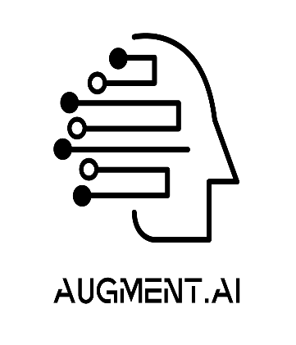

AI - VERSE 2025
TITLE : AI-based Audio Diary
TEAM NAME: IQ Underflow
TEAM MEMBERS: Akash Mahesh, Adithya Balakrishnan, Chinmai Datta Ram, Arpita Patel
USN/ROLL NO:

Slide 2
AI-Based Emotion-Aware Audio Diary
Our solution is an AI-powered voice diary that allows users to talk about their day while the system:
Transcribes speech to text in real-time. Detects emotions from the user's speech. Responds intelligently based on emotions. Tracks emotional trends over time. Provides a summary & insights into emotional well-being.
This solution acts as a mental health companion by helping users reflect on their emotions and track mood patterns.

Slide 3
TECHNICAL APPROACH
Key Technologies Used:
Speech-to-Text: Google Speech Recognition
Emotion Detection: DistilRoBERTa (NLP model)
AI Chatbot: BlenderBot-400M
Text-to-Speech: Google TTS
UI & Frontend: Streamlit
Data Visualization: Matplotlib
How it Works:
User speaks -> Speech converted to text.
Text analyzed -> Emotion detected.
Chatbot responds -> AI-generated empathetic reply.
Emotions logged -> Trends plotted in a graph.

Slide 4
FEASIBILITY AND VIABILITY
Feasibility: Uses open-source AI models, reducing costs. Works offline, ensuring privacy. Lightweight & efficient, can run on most devices.
Viability: Can be expanded into mental health applications. Potential integration with therapy & counseling services. Provides valuable emotional insights for users.

Slide 5
IMPACTS AND BENEFITS
Personal Well-being: Encourages users to reflect on their emotions. Helps track mental health over time.
Technology & Innovation: AI-driven emotion tracking in an interactive format. Blends voice, AI, and mental health into a single tool.
Potential Use Cases: Personal mental health assistant. AI-powered emotional journaling for therapy. Research tool for tracking human emotions.

Slide 6
UPLOAD GIT HUB REPO LINK
https://github.com/akashmahesh2805/audio-diary2.git

